Slide 1


Slide 2

Welcome to camp!
Camp Soaring Eagle '26 Co-Directors:
Ainslie Clark & Courtney Blair
  1st year as co-chairs; 7th year (Ainslie) & 5th year (Courtney) at St. John
    Ainslie: Frances (K) & Norman (4)
    Courtney: Edie (2) & Theo (5)
Camp Soaring Eagle '26 Spirit Coordinator:
Chris Sourov (aka Fundraising Administrator)
  3rd year working on Auction, a Lifetime as part of St. John community
Notes:
Chris is the continuity and the heart of the 'behind the scenes'.

Slide 3
What's an Auction?
That's a great question, we'd love to tell you
  Super fun time together as a community
  We raise money for the school's operating fund through a live auction, silent auction, on-line auction, raffles, art projects, and new this year: interactive raffles
  We love a good theme and the school community goes ALL OUT!

Slide 4
What's Different from Last Year?
What's the Same from Last Year?
Hybrid Dining Options
Activities Before Live Auction
Bar tables, dining tables, and assigned seating if you reserve your campsite
Games & Raffles return during silent auction
Live Auction
Back to a central stage with dining tables around
NO BAR CLOSURE!
Dessert Dash as part of live auction with more variety, less cakes
Live auction & dinner together again
Location & Vibes
Fremont Studios
Stick with Shortened Live Auction
Fewer items, focus on top performing packages
Accessible Event
Ticket costs & availability
Auction Items
Class packages
Classroom Art
Online Items
General Layout of Event
Food
4 tables for buffet style dinner
Expect a Great Time
After Party
Notes:
We've heard a LOT of your feedback and we are cooking up a camp that will be accessible, fun, full of community, and profitable!

Slide 5
How do we make our auction a success?
Donate, Sponsor, Volunteer: We all have something the school needs.

Slide 6
How do we make our auction a success?
Donate to the Auction $250 procurement commitment
  Money: check directly to St. John or donate cash to your class package
  Gift Card(s): on their own or with your class package
  Items (valued at $25 or more are encouraged):
      wine bottle for wine grab
      High-end alcohol
      Family Friendly activities
      Weekend/Week vacations away
      One of a kind experiences
Notes:
Fair Share Tuition Contract
We cannot accept: homemade items, used items, percent-off coupons, software, or live animals/insects.
See website for more details!

Slide 7





How do we make our auction a success?
Sponsor the Auction
  Multiple levels to sponsor, all come with fantastic marketing benefits and our $1,000+ levels come with tickets and additional perks!
Notes:
Sponsorship of the auction underwrites the costs of the event, to ensure $$ raised at the event stays with the school
Logo on banner displayed at school during auction week
Company name/logo displayed on electronic media including the online bidding site, auction website, weekly auction emails and NewsViews, and social media

Slide 8
How do we make our auction a success?
Volunteer for the Auction
  Classroom Auction Coordinators – still looking for a volunteer for 8th (Arruela)
    Classroom Art Projects – PK – 5th grades only
    Classroom Packages
  Lead roles
    Art Projects - filled (thanks Kelly Daniels!)
    Dessert Dash (2) -
    Volunteer Coordinator (2) -
    Procurement (2) - 1 filled (thanks Sarah North!)
    Activities & Decorations (1) -
  Week/Day of/Post-Auction – Set Up, Decorations, Activities, Item Distribution
Notes:
We have descriptions to review with you for the lead roles, if you're interested, find us after the meeting!

Slide 9
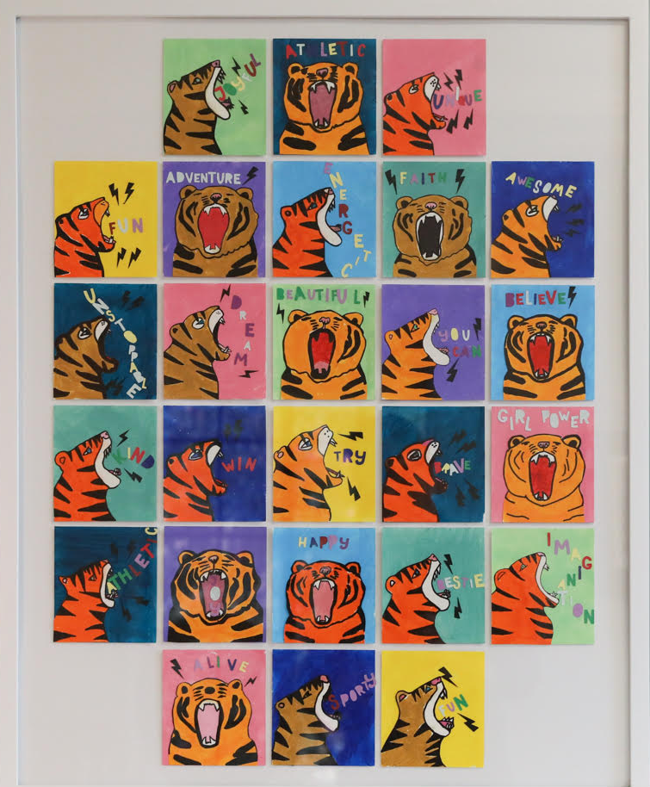
Thank you for volunteering!​
What does an auction coordinator do?​
  Coordinate Art project and class package
    Help build excitement
    Direct questions to the correct place
    Encourage support and attendance of the event

Slide 10
Thank you for volunteering!
What does an auction coordinator do?
  Class Auction Packages
    Examples: Disneyland Trip, Dinner at Canlis, PNW Getaway Weekend, Unique Experience for Families
    How do I pull together the package?
      Decide what you want to do and ask for monetary or other donations
      Seek ideas from your class – does someone have a nice home in Palm Springs? A boat to offer a day adventure on? A timeshare in Chelan? Tickets to a major concert or sporting event?
    Auction Team will send out a “Auction Coordinator” tool kit next week.
Notes:
Auction team will send out a Classroom Auction Coordinator email next week with art ideas, package ideas (and dream scenarios and will include a submission form for package approval, donation tracking sheet, procurement form.
) to get your creativity flowing. Work with your class parents to come up with your package plan and art projects ideas. We ask that these ideas and plans to be submitted by December 12 so there's time to ensure uniqueness between classes.

Slide 11
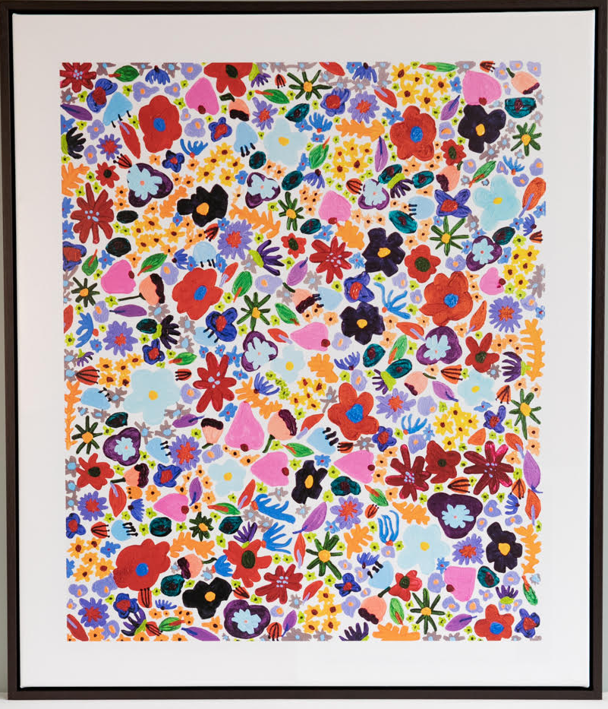
Thank you for volunteering!
What does an auction coordinator do?
  Classroom Art (grades PreK – 5)
    Coordinators do not need to lead classroom art project if they do not want to
    Coordinators can seek volunteers from their class to lead the project
    Project ideas should be approved by the Auction Team by Dec. 12
    Art projects have a budget of $250 (to be reimbursed to the project lead)

Slide 12
Thank you for volunteering!
What do the Lead roles do?
    Dessert Dash (1-2) - Get those s’mores toasting!
    Design & purchase the dessert table decorations in coordination with the auction team. Determine dessert donation asks, coordinate volunteer sign-ups, pick-up desserts as needed and arrive early to Fremont Studios to set up the dessert table and host during the auction. Note - you will be able to enjoy the auction outside of dessert dash if you plan to attend.

Slide 13
Thank you for volunteering!
What do the Lead roles do?
    Volunteer Coordinator (2) - Help us keep the camp staff organized!
    The majority of the work is done in the 4 weeks leading up to the auction as well as the day of. Includes setting up the signup genius, coordinating who needs to be where/when, sending reminder emails with job descriptions, and if possible, be at Fremont Studios during set-up and/or arrive early to event to direct volunteers as they arrive.

Slide 14
Thank you for volunteering!
What do the Lead roles do?
    Procurement (2) - Want to go fishing…for donations?
    Solicit businesses for donations to help round out our catalog. Follow-up and submit procurement forms as needed. On your own time from now until the procurement deadline of Feb 12.
    1 filled (thanks Sarah North!)

Slide 15
Thank you for volunteering!
What do the Lead roles do?
    Activities & Decorations (1) - Help us set up camp!
    In coordination with the Auction team, plan for& acquire decorations and, most importantly, be on site on March 27 to lead volunteers for set-up of activity stations and decorations.

Slide 16

What's Coming Up:
Auction Team will send out Auction Coordinator toolbox next week
Talk up the auction with your friends - figure out who you want to sit with and plan for reserving a campsite!
Read the Auction emails weekly
Get procuring, first date is 12/5/2025 for a chance to win one free auction ticket!
Art & Package ideas due 12/12/2025
Sponsor Us! 12/12/2025 is early bird deadline for 10% discount

